Slide 1

Patient organizations in Czechia
SANITAS workshop in Warsaw
12th April 2024

Slide 2
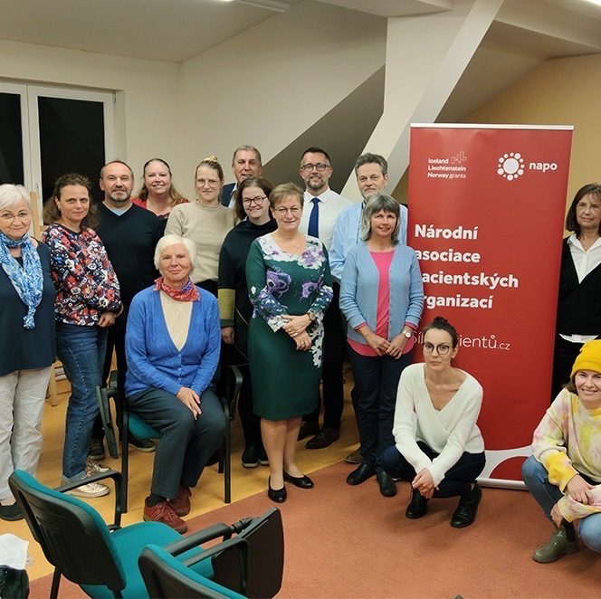
National Association of Patient Organizations (NAPO)
Founded in Nov 2021
Currently 47 members
(36 therapeutical groups)
https://silapacientu.cz/en/

Slide 3
Organization of the patient segment in Czechia
/ prior 2022
Any organization providing services to patients
a legal person
self-proclaimed list of activities
can be profiled at the MoH website

Slide 4
Organization of the patient segment in Czechia / since 2022
Organizations helping patients
Any organization providing services to patients, must be a legal person
156 organizations profiled at the MoH website
Patient organizations
Must be a legal person and meet a legal definition of pat. organization
41 organizations certified by MoH (1st Apr 2024)

Slide 5
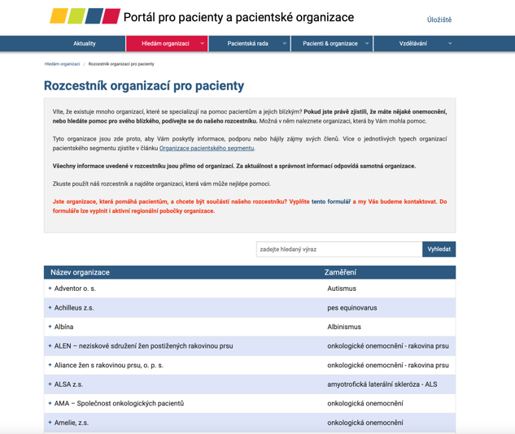
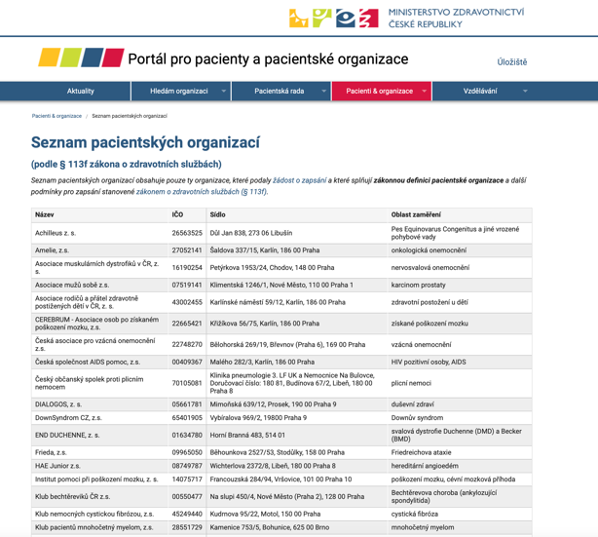
Organization of the patient segment in Czechia
https://pacientskeorganizace.mzcr.cz/index.php?pg=hledam-organizaci--databaze
https://pacientskeorganizace.mzcr.cz/index.php?pg=pacientske-organizace--seznam-pacientskych-organizaci

Slide 6

What brought the change to the system?
MoH recognized active involvement of patients in the healthcare system and the role of patient organizations (2017):
  Patient Rights’ Department
  Patient Council – MoH’s advisory body
  (24 members)
Patient organizations started to be more assertive
- Czech Association of Rare Diseases (ČAVO)

Slide 7
What defines a patient organization?
No universally accepted definition for a patient organization
“Patients’ organisations are defined as not-for profit organisations which are patient focused, and whereby patients and/or carers (the latter when patients are unable to represent themselves) represent a majority of members in governing bodies”.
European Medicines Agency (EMA)

Slide 8
Czech definition of a patient organization
A registered association whose main activity is to assist patients and protect their rights and interests and whose members are usually:
persons with a specific illness or disability,
their relatives or their representatives under the Civil Code,
and whose members have a decisive influence on its management.
(§ 113f of Health Services Act, no. 372/2011 Coll.)

Slide 9
Czech definition of a patient organization
Legal forms:
  registered association (patients are members) / “zapsaný spolek” (stowarzyszenia?)
  registered institute / “zapsaný ústav” (fundacje?)
  public benefit corporation / “obecně prospěšná společnost” (organizacje pożytku publicznego?)

Slide 10
Czech definition of a patient organization
“A decisive influence on its management”
Members of the statutory and supreme body are elected by the members of the association who are usually:
patients,
their relatives,
their representatives under the Civil Code,
other patient organizations.
Notes:
Representatives under the Civil Code – for patients deprived of their legal capacity by the court

Slide 11
Additional conditions for obtaining a patient organization status
Patient organization must:
publish on its website its financial statements and its sources of funding
be active for at least 12 months prior to application
(provide services to patients and protect their rights and interests)

Slide 12
Application for obtaining a patient organization status
Patient organization must submit:
Application
Sworn affidavit on meeting the legal definition of patient organization
Statutes (articles of incorporation/founding agreement)
Annual report
Financial statements

Slide 13
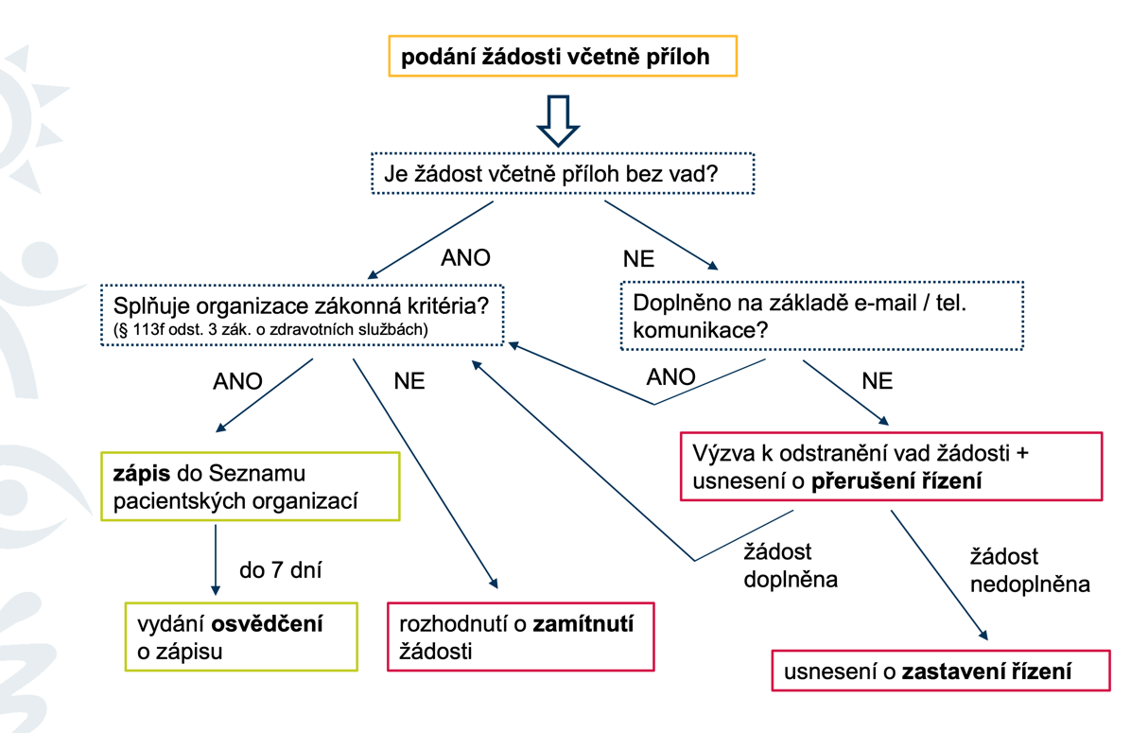
Application process

Slide 14
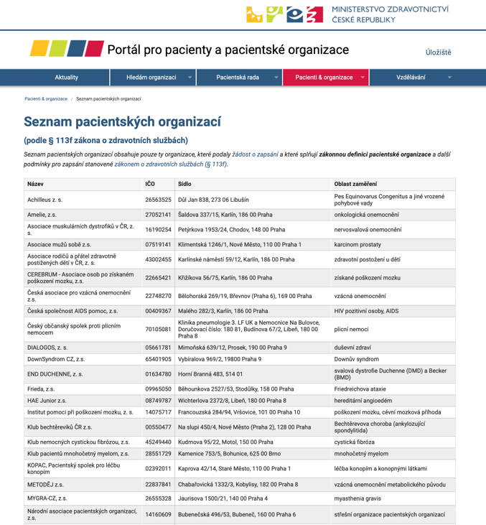
Patient organization certification

Slide 15
Types of patient organizations
Umbrella organizations in Czechia
National Association of Patient Organizations (NAPO) – 47 members
Rare Diseases Czech Republic (ČAVO) – 48 members
Alliance of Patients with Diabetes
– 5 members
Alliance of women living with breast cancer – 38 members
Voice of Oncology Patients – 12 members
…
Disease specific
Regional, national, pan-European
Umbrella organizations

Slide 16

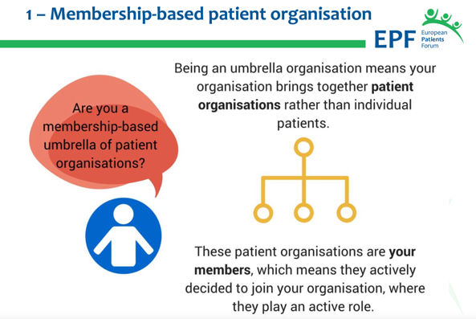
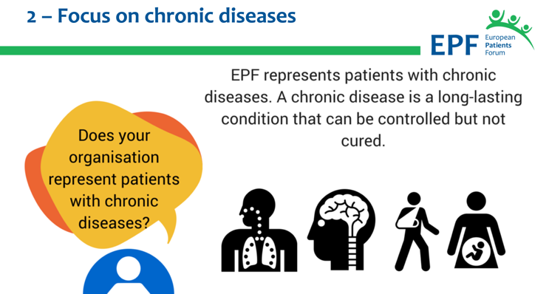
NAPO as an umbrella patient organization
Inspired by European Patient Forum

Slide 17
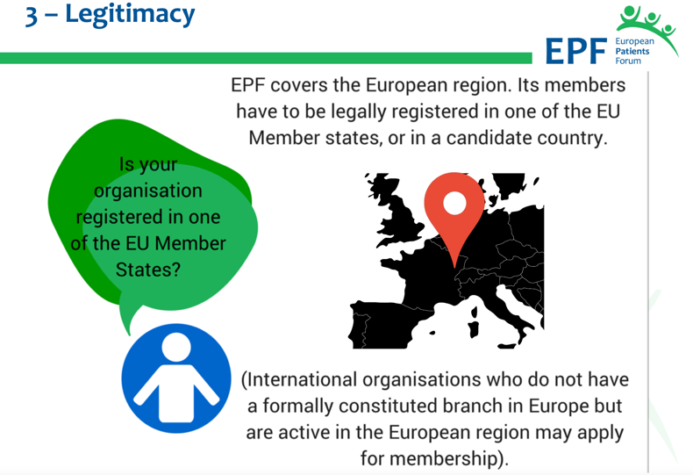
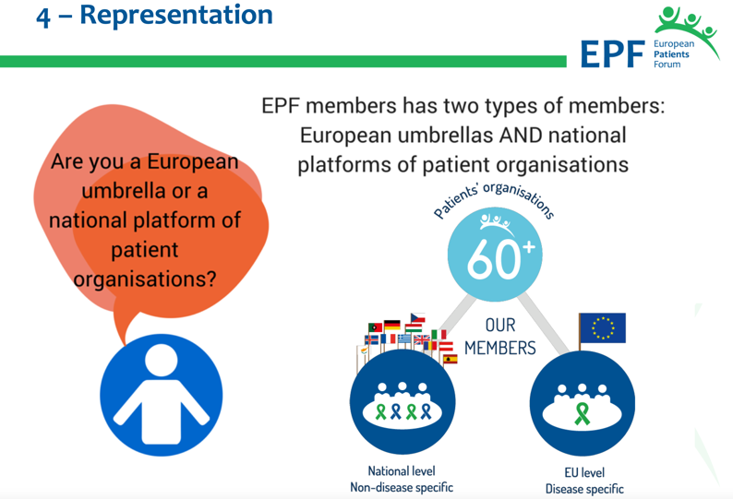
NAPO as an umbrella patient organization

Slide 18
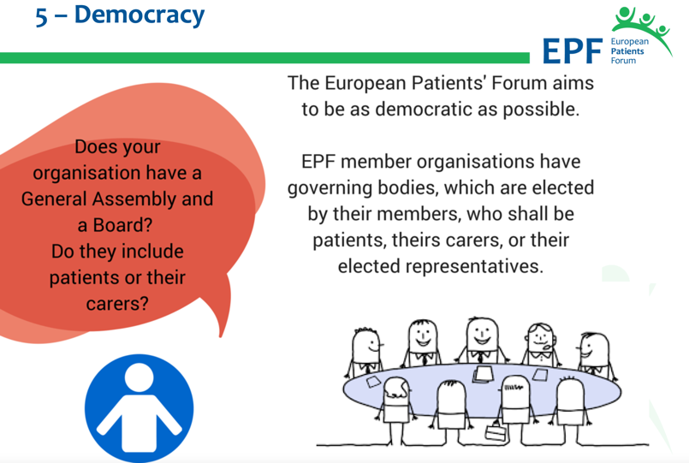

NAPO as an umbrella patient organization

Slide 19
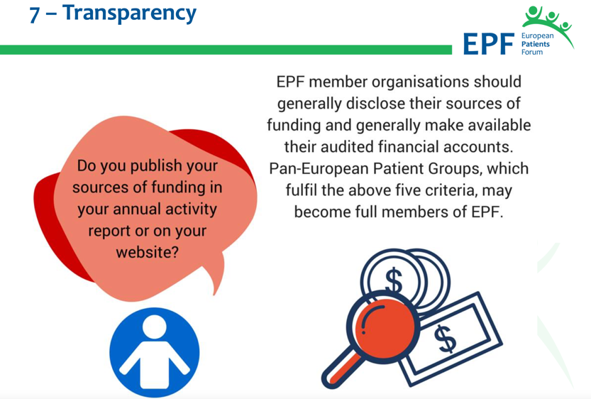
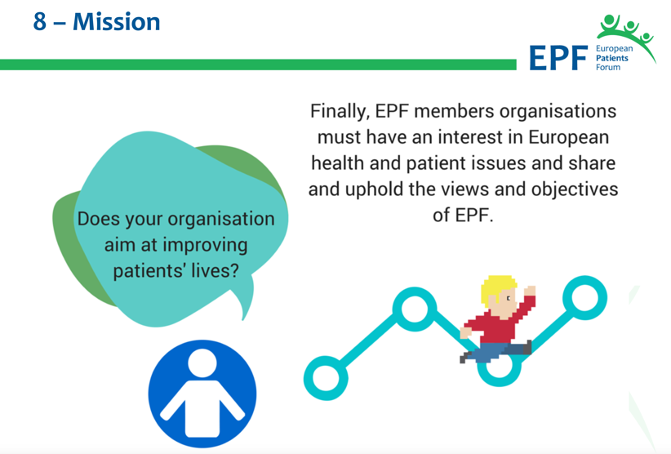
NAPO as an umbrella patient organization

Slide 20
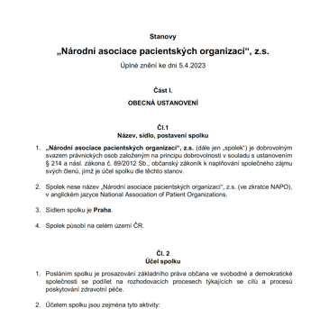
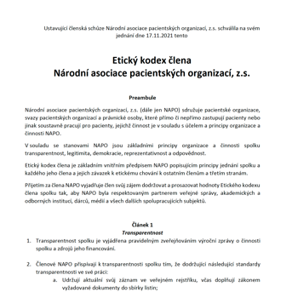
NAPO as an umbrella patient organization
Statute
Definition of PO (membership) | Patients in statutory or supreme body
Code of Ethics
Transparency | Records in public registries, annual report and financial statement by 31 Aug on website
Legitimacy | Truthful information about meeting the statute conditions
Democracy | Patient organization represented at NAPO by a patient
Representation | Member provides information on its membership and number of patients
Responsibility | Endorsement of common positions
Zero corruption | Anti-corruption rules

Slide 21
NAPO as an umbrella patient organization
Funding – no more than 40% funding from pharma industry
Strategic priorities (defined by members + political reality)
Partnerships
Voice of patient experts via NAPO

Slide 22
Strategic priorities defined by members
E-health and health data
Medicines & access to treatment
Health policies
PREVENTION
Training & capacity building

Slide 23

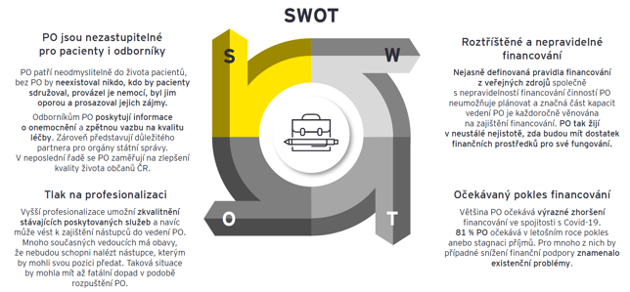
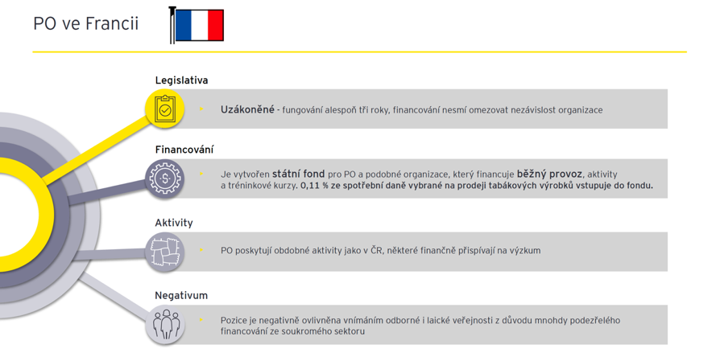
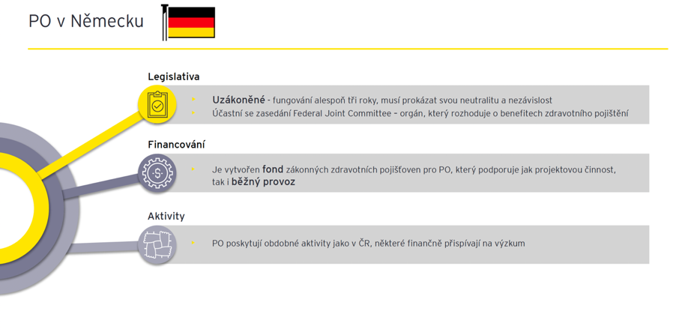
Funding of patient organizations in Czechia

Slide 24
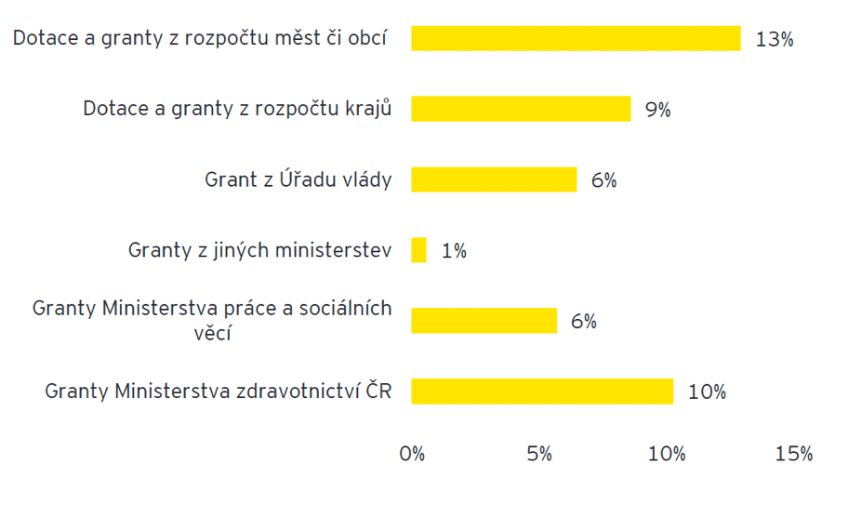
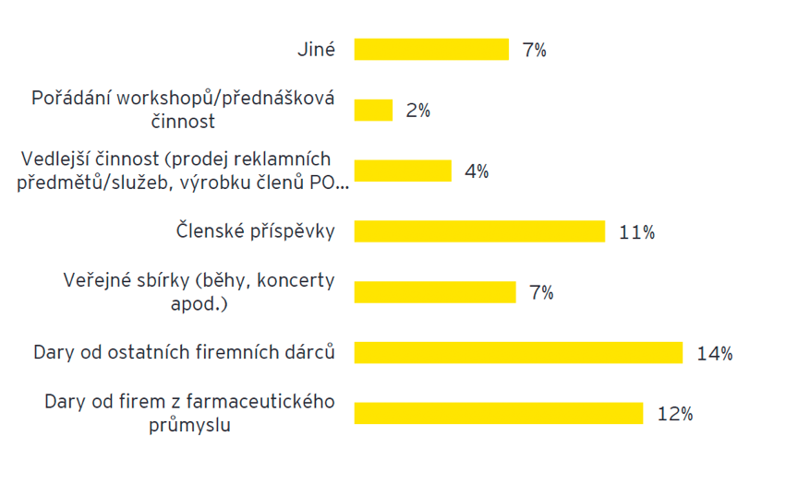
Funding of patient organizations in Czechia
Public funding
Non-public funding
Notes:
For 35% of PO public funding makes >50% of their annual budget
Pharma + private sector – on average 26% of annual budget

Slide 25
Strategic priorities defined by political reality
EU legislation (EHDS, EU pharma package)
E-health legislation
Emergency dispensation of medicines in pharmacies
Definitions of person's entitlement to a health service
“Right to be forgotten"
Drug supply shortages (Rx online)
Access of Ukrainian refugees to Czech healthcare system
…

Slide 26
Partnerships
European Patient Forum (EPF)
Association of Innovative Pharmaceutical Industry (AIFP)
Czech Association of Pharmaceutical Firms (ČAFF)
Czech Medical Association of J. E. Purkyně
Czech National Disability Council
Alliance for telemedicine, digitalisation of health and social services
Association of Manufacturers and Suppliers of Medical Devises
Health Insurance Office

Slide 27
State vs. patient organizations
Formal involvement only via :
Patient Council (MoH working groups, Patient Council working groups, comments on new proposed health legislation)
HTA process for (treatment of rare diseases)
Informal involvement via NAPO (media, patient advocacy at working groups, patient conferences, Parliament hearings, State Drug Control Authority)

Slide 28
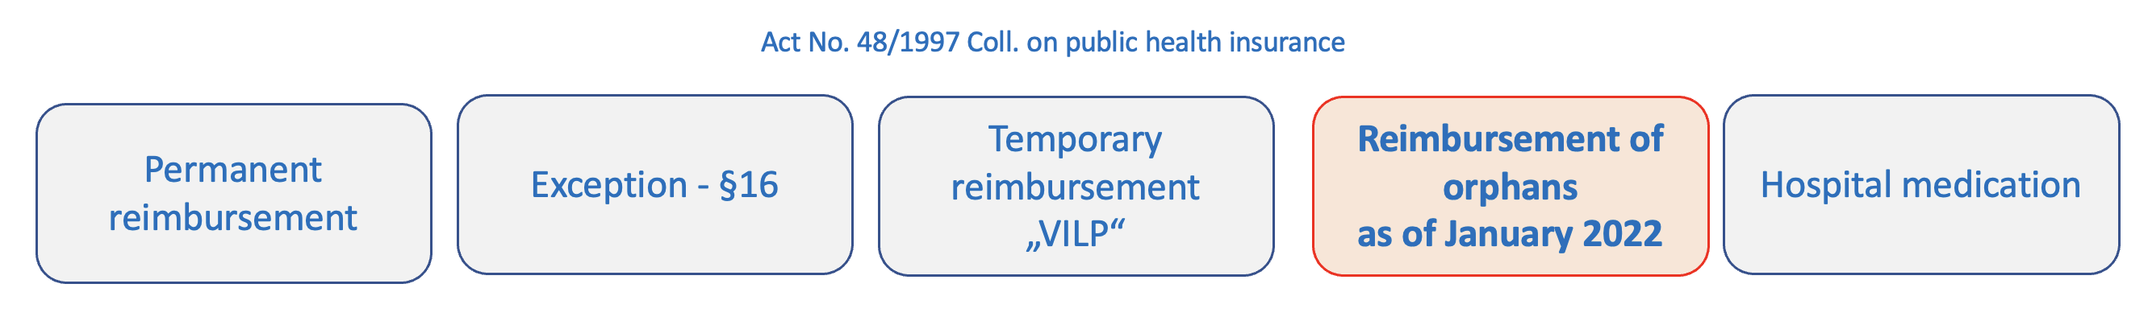
Patient organizations involvement in HTA
Participation of patients in the administrative proceedings:
  1. phase: taking part in the evaluation process
  2. phase: taking part in the MoH Advisory Board – decision making process (final recommendation for the minister)

Slide 29
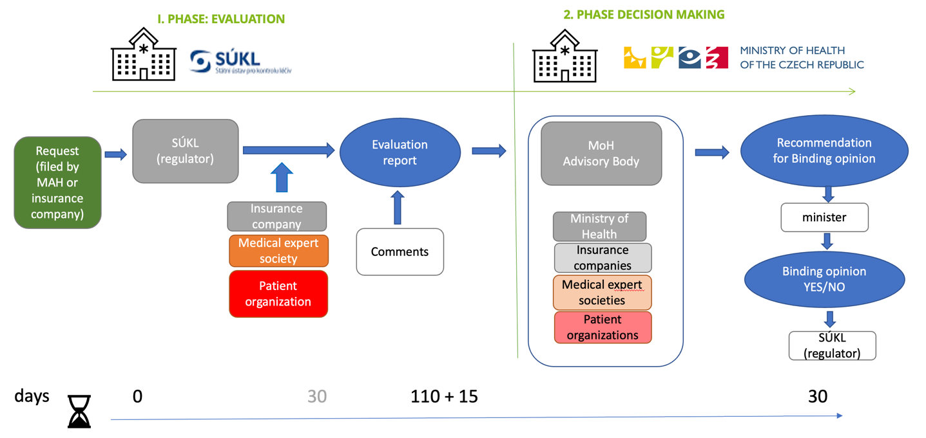
Patient organizations involvement in HTA

Slide 30
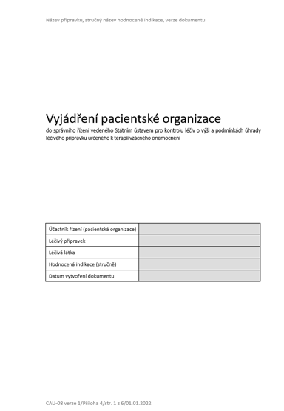
PO involvement in HTA / 1st phase
WHO
PO according to the definition registered on the MoH List of POs
In case of absence of PO (ex. ultra-rare orphans), Rare Diseases Czech Republic represents
Structured opinion of PO
WHAT
….its (orphan) demonstrable contribution to improving the patient's quality of life …

Slide 31
PO involvement in HTA / 2nd phase
WHO
PO registered on the MoH List of POs named by the health minister to represent in the Advisory Body
  Cannot be in conflict of interest
  Proposed by the Chair of the Advisory Body
  2 named representatives of POs
WHAT
Evaluate criteria and parameters for making decision based on Evaluation report issued by the regulator
Each member votes on its own behalf
Advisory Body meets to decide on one orphan reimbursement at a time.
Who decides:
  2 representatives of state (MoH)
  2 representatives of insurance companies
  2 representatives of expert societies
  2 representatives of patient organizations

Slide 32

Should patient organizations be apolitical?
apolitical
adjective
not interested in or connected with politics,
not connected to any political party.

Slide 33
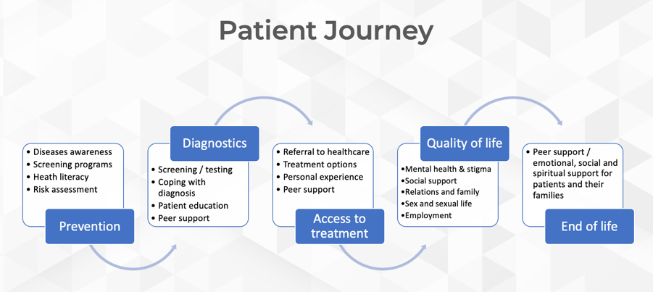
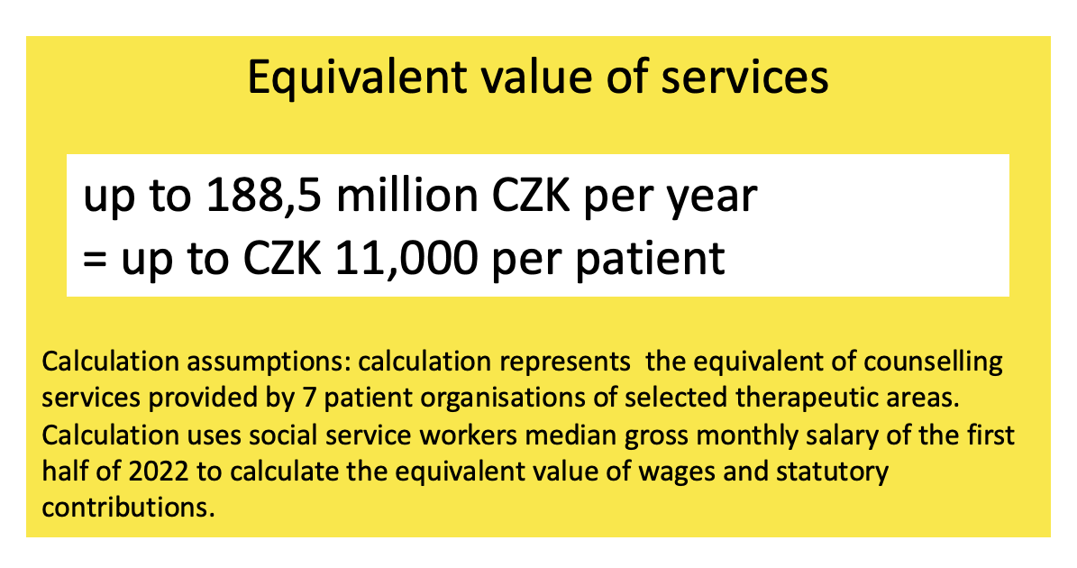
NAPO – advocate for patient organizations

Slide 34
Q & A

Slide 35
THANK YOU
Robert Hejzák
hejzak@silapacientu.cz

